Slide 1
Airbnb
Anisha Ganeshkumar
Melissa Scholem Heller

Slide 2

Data Description
Purpose of Project : To find interesting patterns and to communicate them clearly and efficiently
89 Variables including:
country, city, room type, accommodates,etc..
Several variables are text or image based
Data extremely dirty
447313 observations (rows)
Source : https://public.opendatasoft.com (public data from Airbnb)

Slide 3
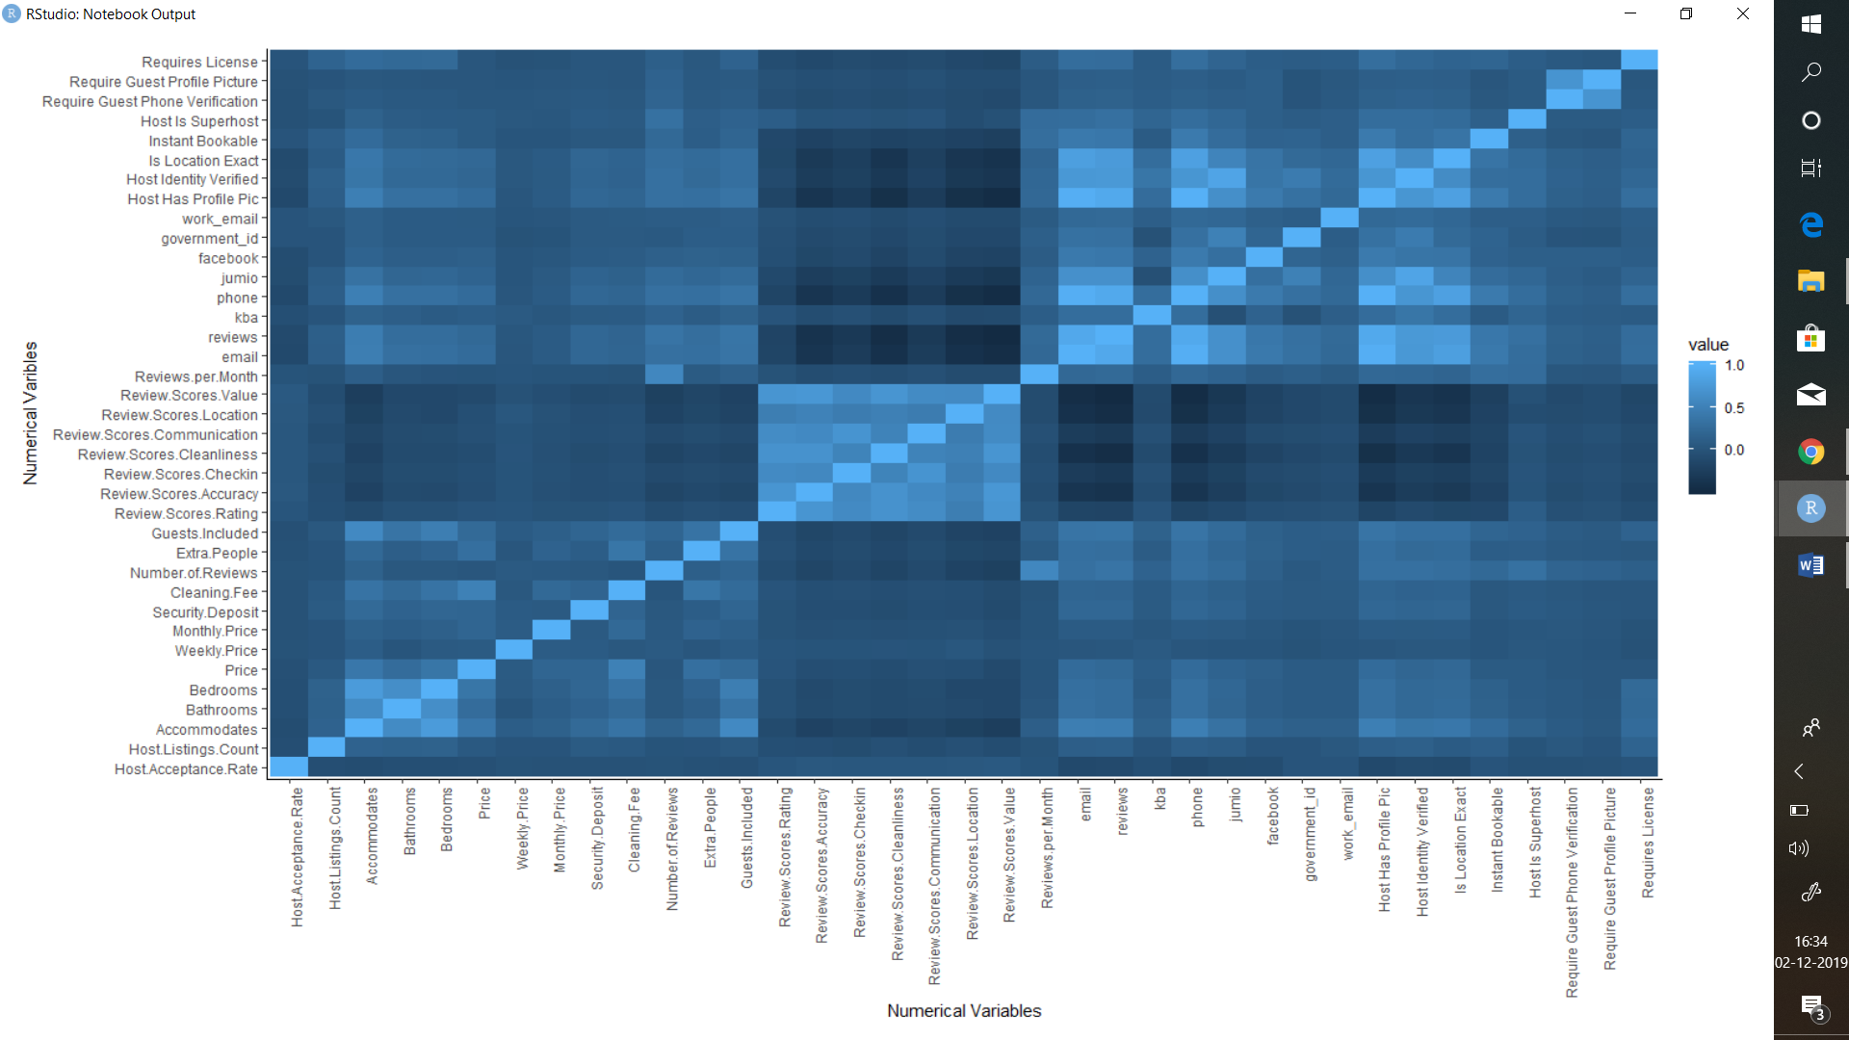


Heat map showing correlations:

Slide 4
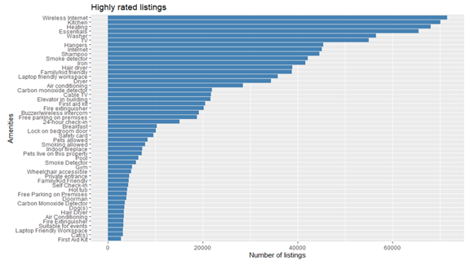
Top amenities that gets you high score:

Slide 5
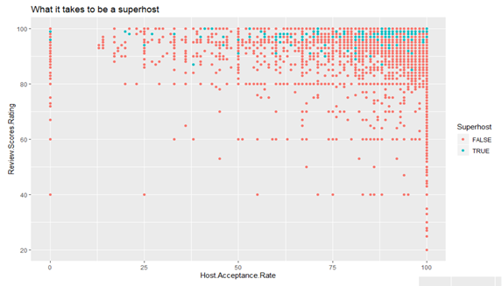
What does it take to be a superhost?

Slide 6
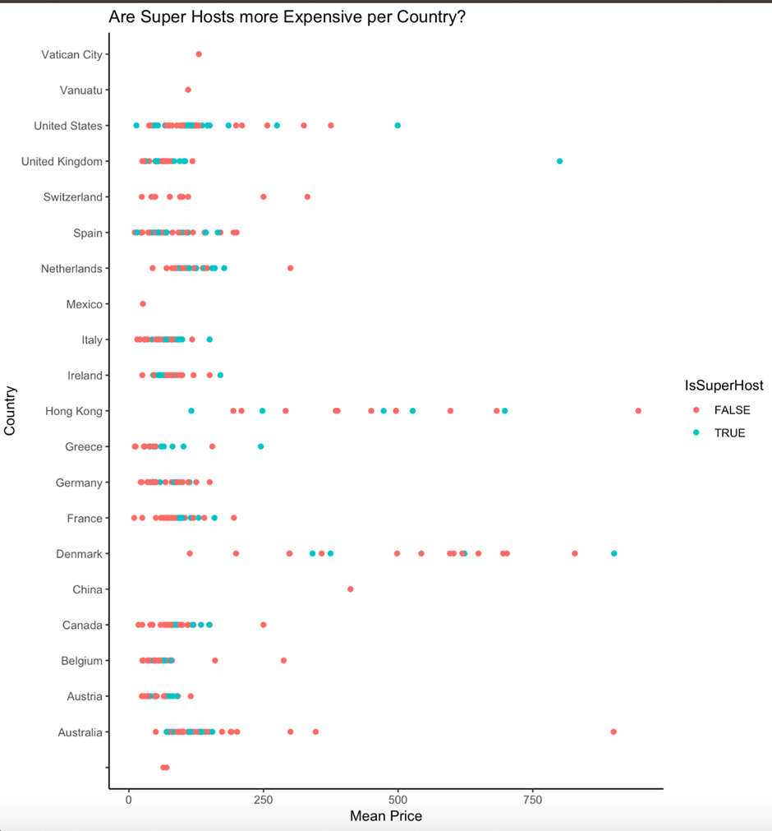
Are superhosts more expensive?

Slide 7
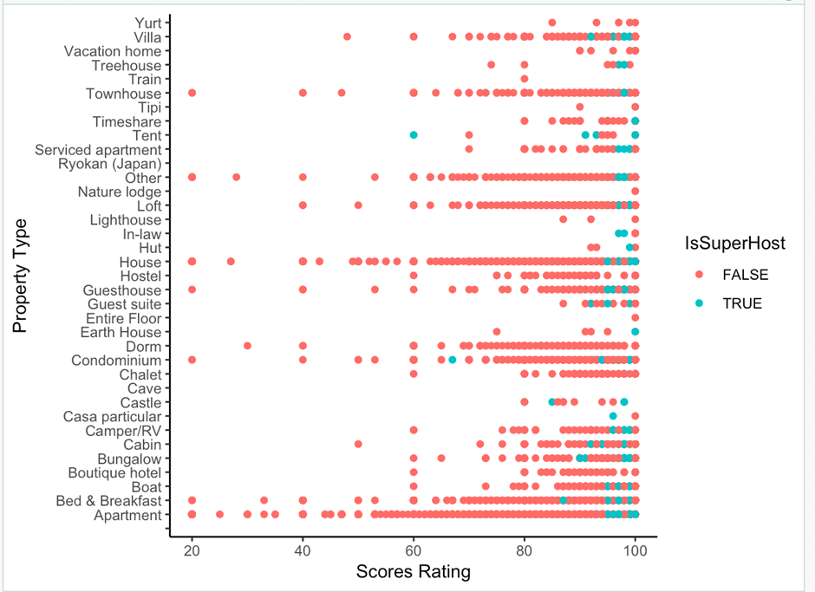
Properties with high ratings in Airbnb:

Slide 8
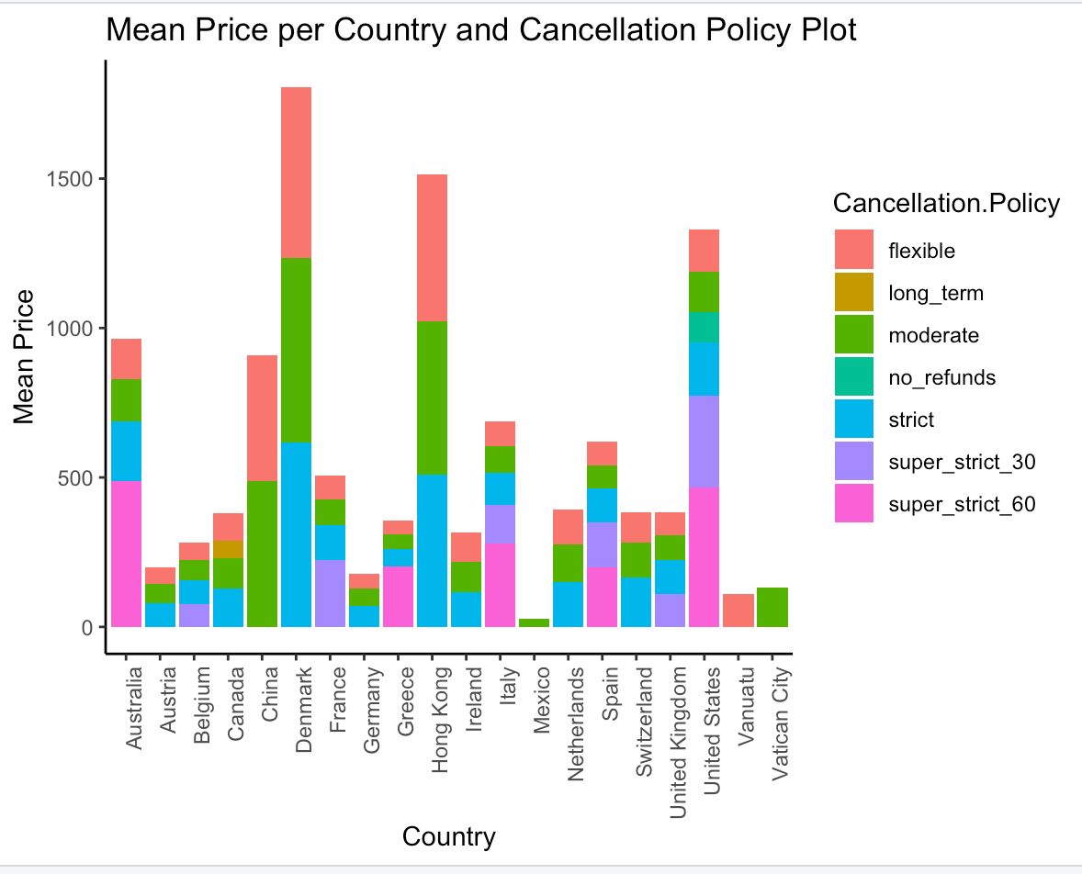
Cancellation policies by country:

Slide 9
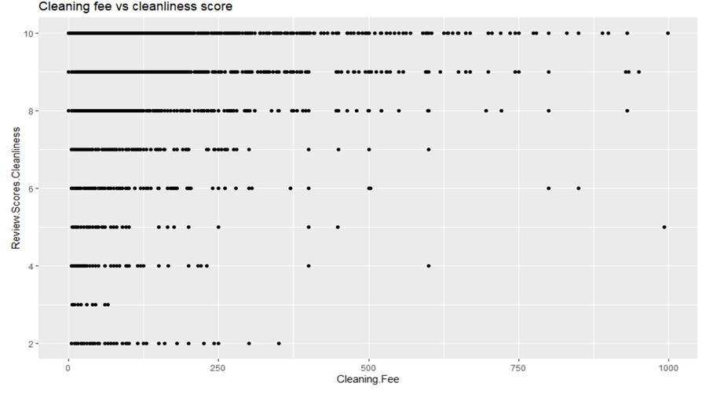
Does high cleaning fee means high cleanliness?

Slide 10
Challenges
The magnitude of dataset remote access to a ‘supercomputer’ to reduce the dimensions of data set.
Converting several of the columns into numeric columns
Convert columns into categorical columns with defined outcomes (Cancellation Policy)
Create binary categories for verifications of a Host (Gov Id/Facebook : 1,0) and Amenities provided by the listings
A lot of missing values
For future use text and image columns as well as use NLP

